Slide 1


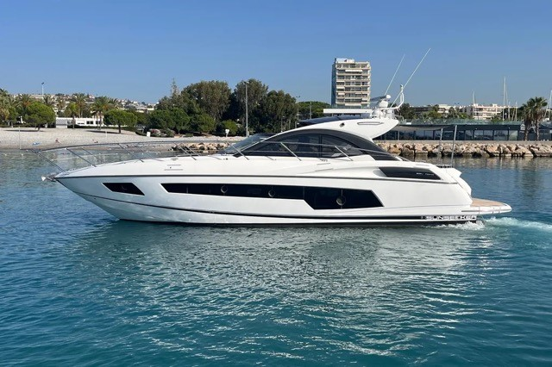


SUNSEEKER SAN REMO 485| 2014| 495.000 € | TAX PAID
Year :
L.O.A:
Beam:
Engines
Hours:
Lying:
2014
15,70
4,30
2
500
XXXXX
Fuel:
Cabins:
Flag:
TAX:
Price:
Comments
1320
2
UK
PAID
495.000€
VERY GOOD IN PRICE

Slide 2
NAVIGATION EQUIPMENT
2 X VOLVO PENTA IPS 600 – D6-435 HP
JOYSTICK WITH DYNAMIC POSTIONING SYSTEM (DPS)
WHITE HULL
WALNUT INTERIOR FURNITURE
DARK WOODEN SALOON FLOOR
BLACK AVONITE TO GALLEY SURFACE
CREAM CARPET FITTED TO CABIN AREAS
SALOON LEATHER UPHOLSTERY
ADDITIONAL EQUIPMENT
WHITE HULL
WALNUT INTER FURNITURE
DARK WOODEN SALOON FLOOR
BLACK AVONITE TO GALLEY SURFACE
CREAM CARPET FITTED TO CABIN AREAS
SALOON LEATHER UPHOLSTERY
SIDE POWER BOWTHRUSTER
ONAN GENRATOR DIESEL 9,5 KWA
WATERMAKER IDROMAR
BESENZONI PASARELLE
HYDRAULIC PLATFROM
MARINE AIR AIRCON TO ALL CABINS
ELECTRIC GLASS COCKPIT SUNROOF
COCKIPT GARAGE FOR TENDER
TEAK TO COCKPIT, PLATFROM AND SIDE STEPS
ELECTRIC MOORING WINCHES LEWMAR
MASTERVOLT BATTERY CHARGERS X 2
SIMRAD AUTOPILOT
FUSION RADIO STEREO
REFRIGERATOR AND
ICEMAKER IN COCKPIT AREA
WETBAR
LEWMAR AND SINK
3 X TV TO CABINS AND SALOON
DOMETIC FRESH WATER SYSTEM TOILETS
ELECTRIC HOB AND REFRIGERATOR IN SALOON
SUNBATHING ADJUSTABLE CUISHONS TO BOW AREA
BROKER COMMENTS
The boat is currently in a mooring in Palma de Mallorca, and in good condition. If you'd like to see it in person, feel free to contact us.

Slide 3
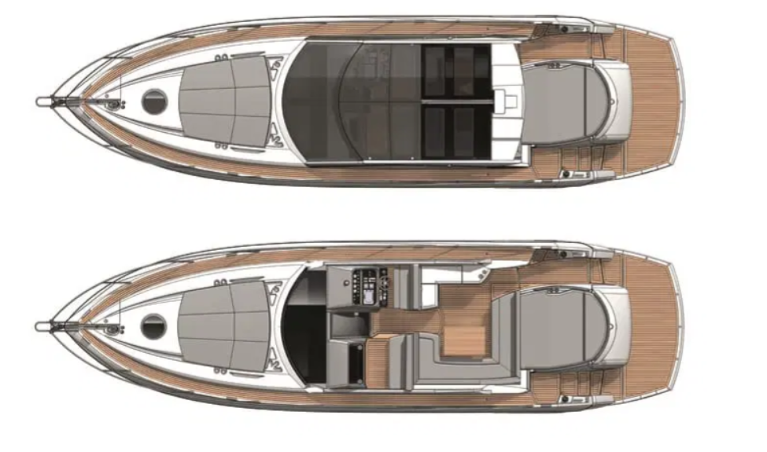
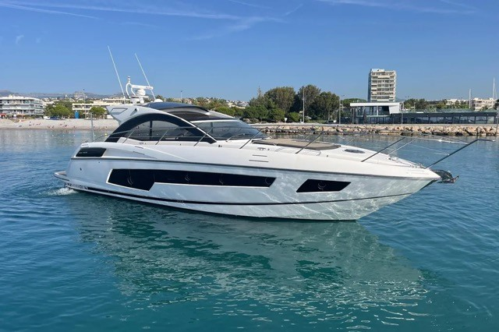
PHOTO GALLERY

Slide 4
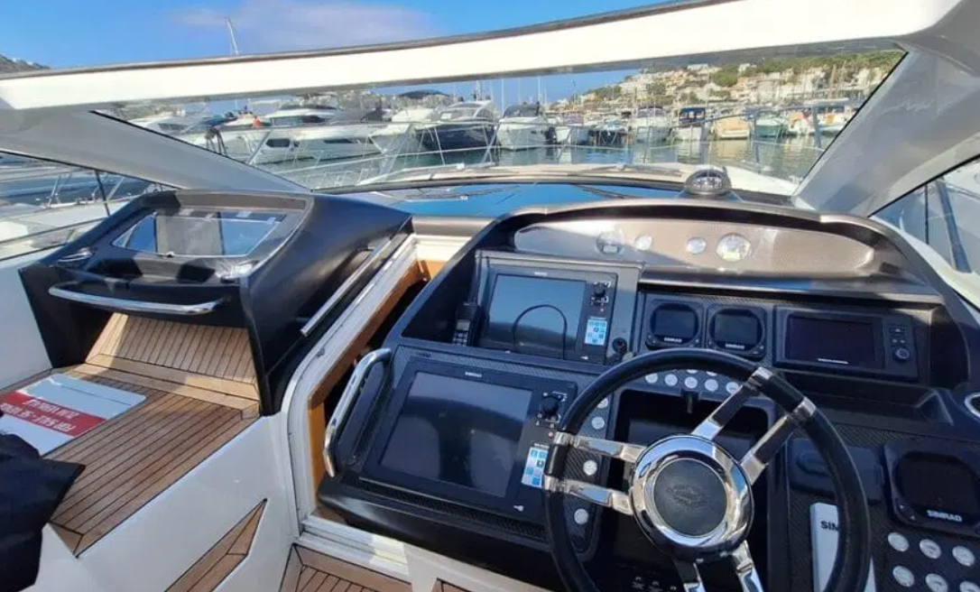
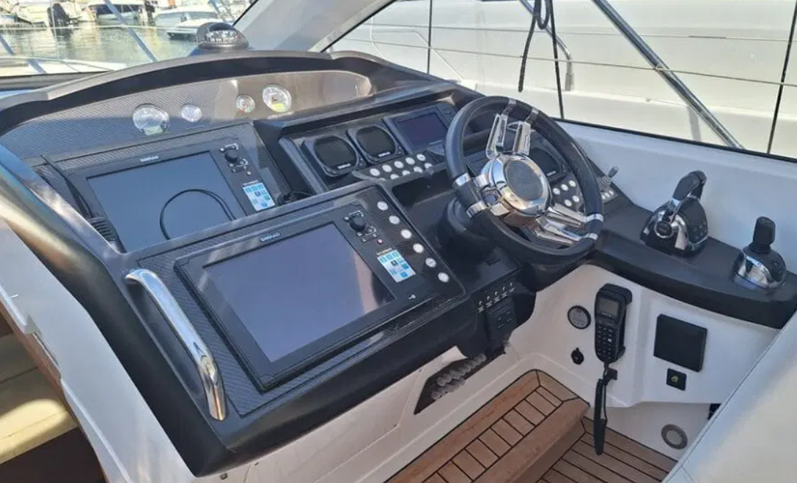
PHOTO GALLERY

Slide 5
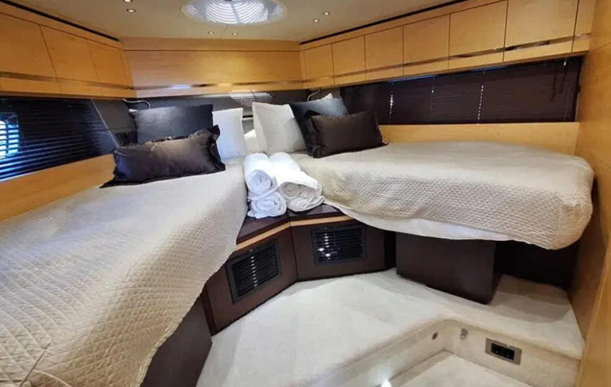
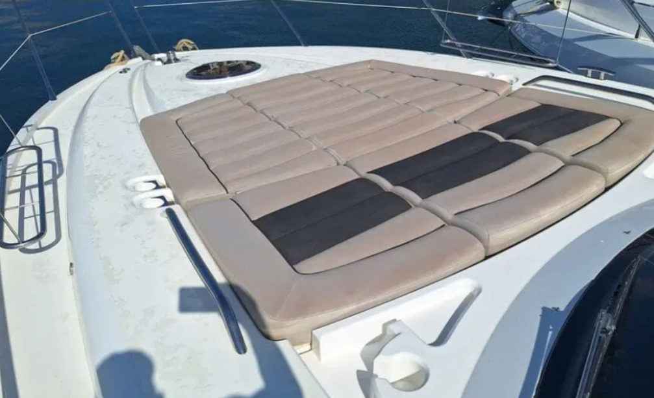
PHOTO GALLERY
see more photos on our web internautic-Yachts.com
All particulars are believed to be correct but are not guaranteed

Slide 6
The Sunseeker San Remo 485 is an ultra-modern sports yacht. Design, comfort and high technology combine to offer a new way of sailing. Hard top, submersible bathing platform, sundeck fore and aft, dinghy garage, joystick, IPS, 2 cabins, 2 toilets, are some features that will catch your attention. The Sunseeker San Remo 485 is in excellent condition, moored in Mallorca (Spain) and available for viewing.
Make: Sunseeker
Model: San Remo 485
Year: 2014
Flag: UK
Engine power: IPS 600 D6 435 HP
Engine power: Volvo Penta
Length overall: 15.70 m
Beam: 4.30 m
Draught: 1.30 m
Length of register: 13.90

