Slide 1


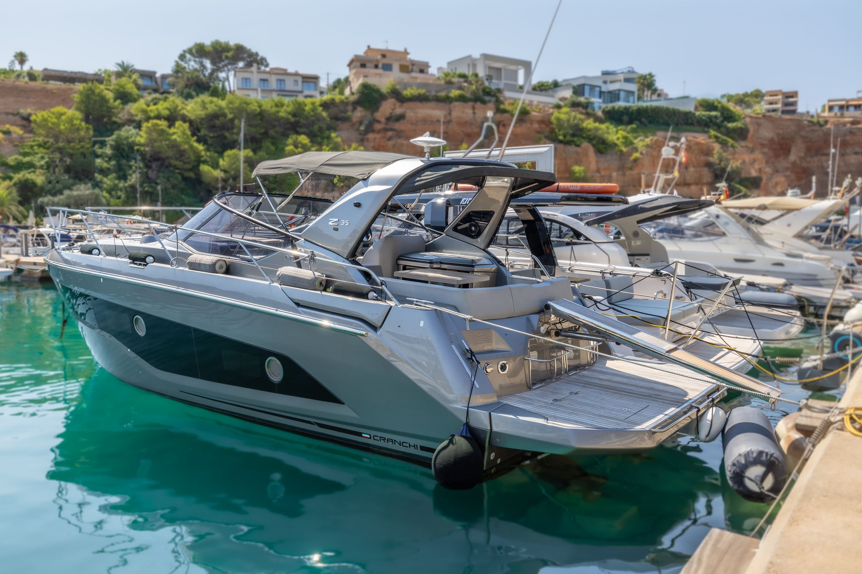


CRANCHI Z 35| 2019| 280.000 EUR | TAX PAID
Built 2019
11,70 / 9,99 mts
3,49 mts
2 x D4 270 HP VOLVO
230
Balearic Islands
Fuel:
Hull :
Flag:
TAX:
Price:
Comments
600 lts
Mercury Grey
German
Paid
280.000 EUR
In Very good general conditions. Tax paid
Year :
L.O.A:
Beam:
Engines
Hours:
Lying:

Slide 2
NAVIGATION EQUIPMENT
JOYSTICK, 9' GARMIN SCREEN, SONAR, GPS, PLOTTER, AUTOPILOT, RUDDER DIRECTION INDICATOR, HORN, ANCHOR WINCH SWITCH IN WHEELHOUSE. BOW`PROPELLER
ADDITIONAL EQUIPMENT
BIMINI TOP, WALKWAY, HOT WATER SHOWER, TWO REFRIGERATORS, TEAK PICNIC TABLE, BATTERY CHARGER WITH 220V CABLE, TVWITH GLOMEX ANTENNA, MARINE TOILET, SHOWER WITH SCREEN, TEAK DECK FLOORING, MUSIC SYSTEM, TWO CABINS, SUN DECK AT BOW AND STERN.GENERATOR, AIR CONDITIONING, CAMPER COVER, OUTDOOR GRILL AND FRESH WATER SINK
BROKER COMMENTS
In Very Good general conditions, well maintained with service history available.

Slide 3
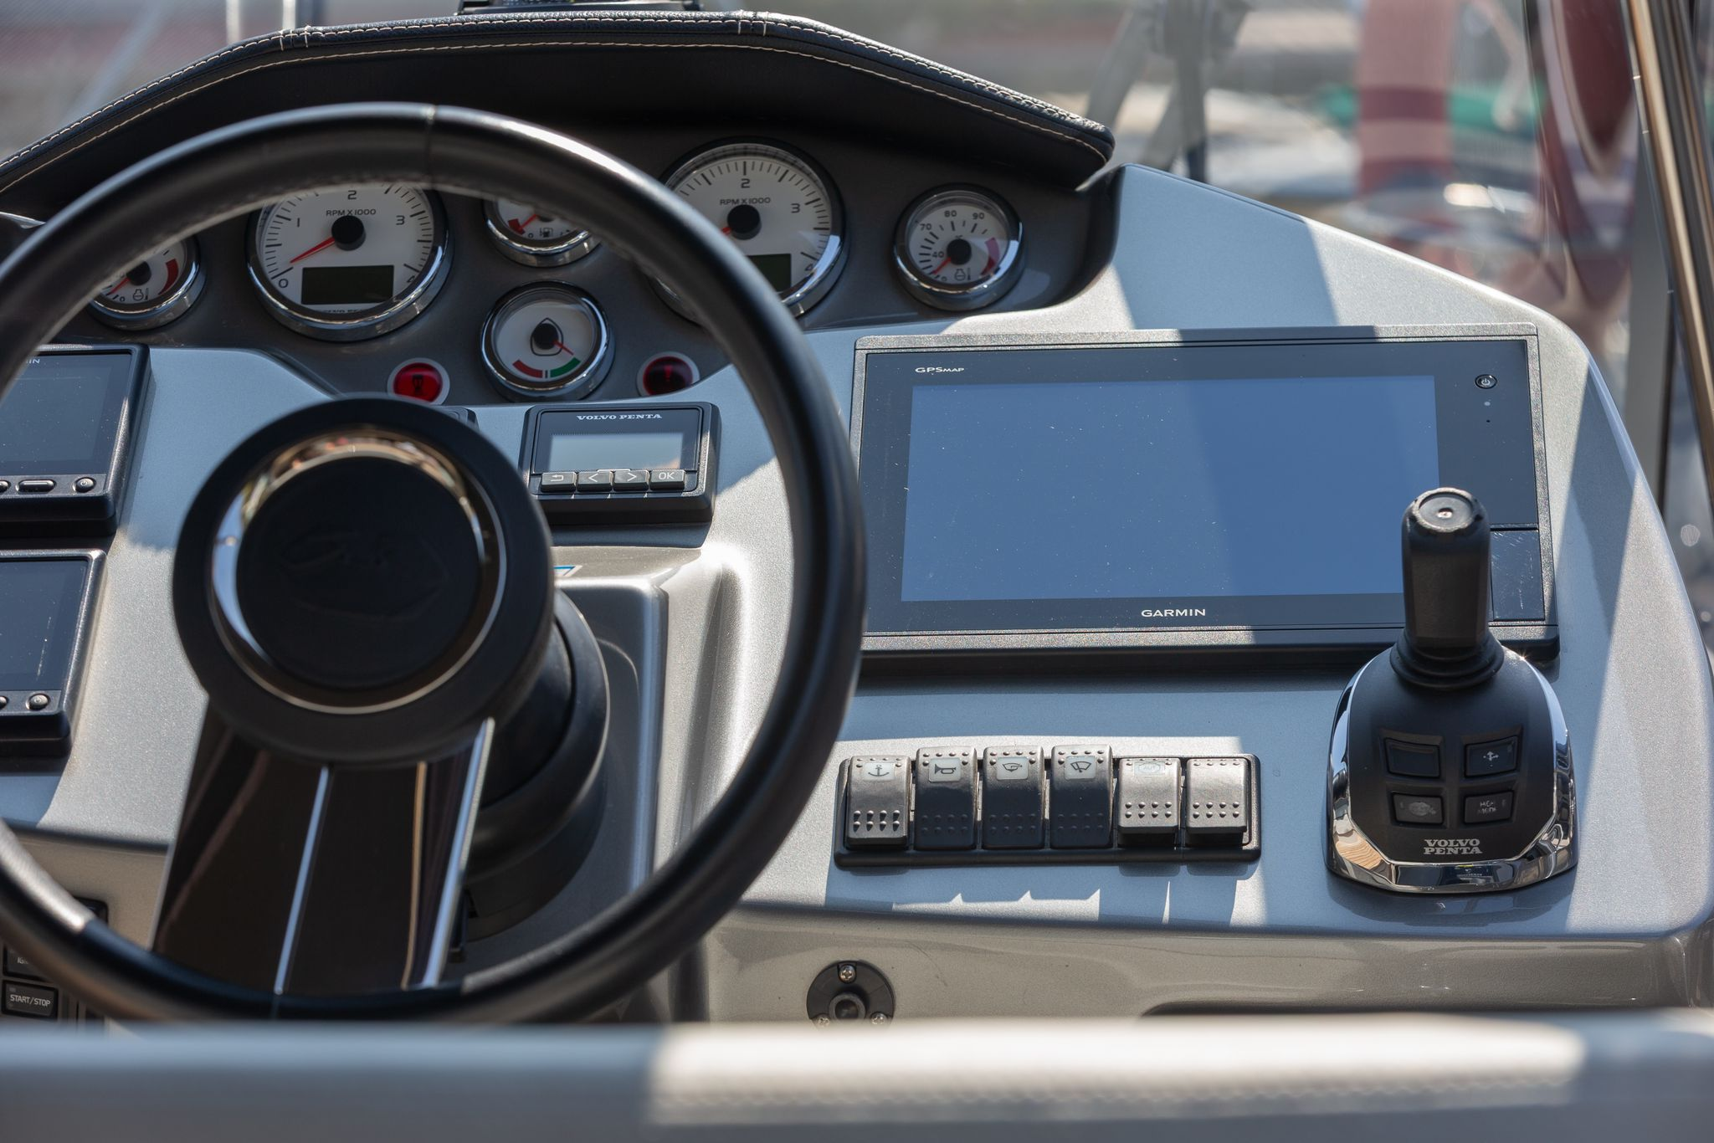
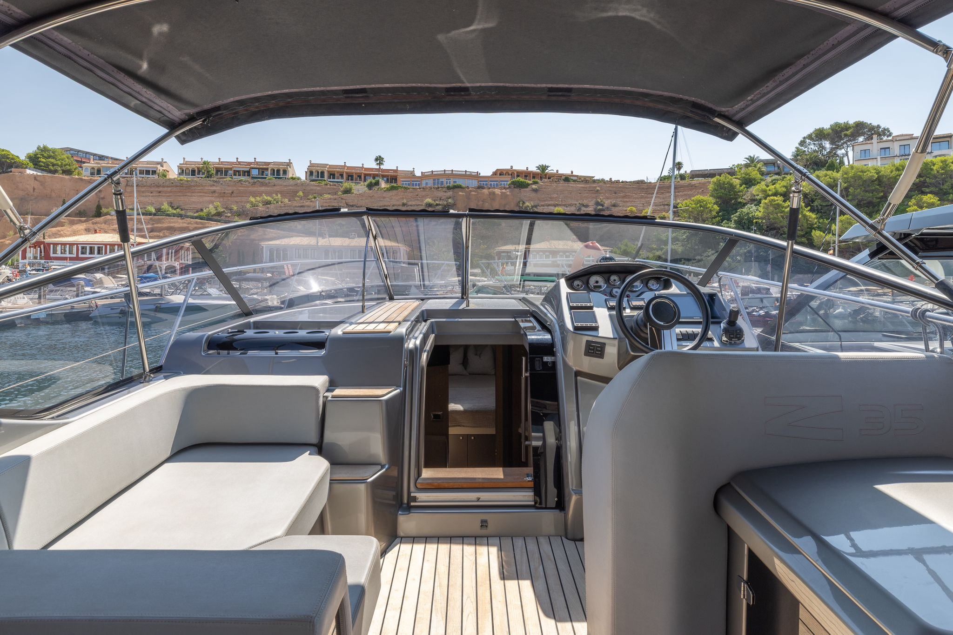
PHOTO GALLERY

Slide 4
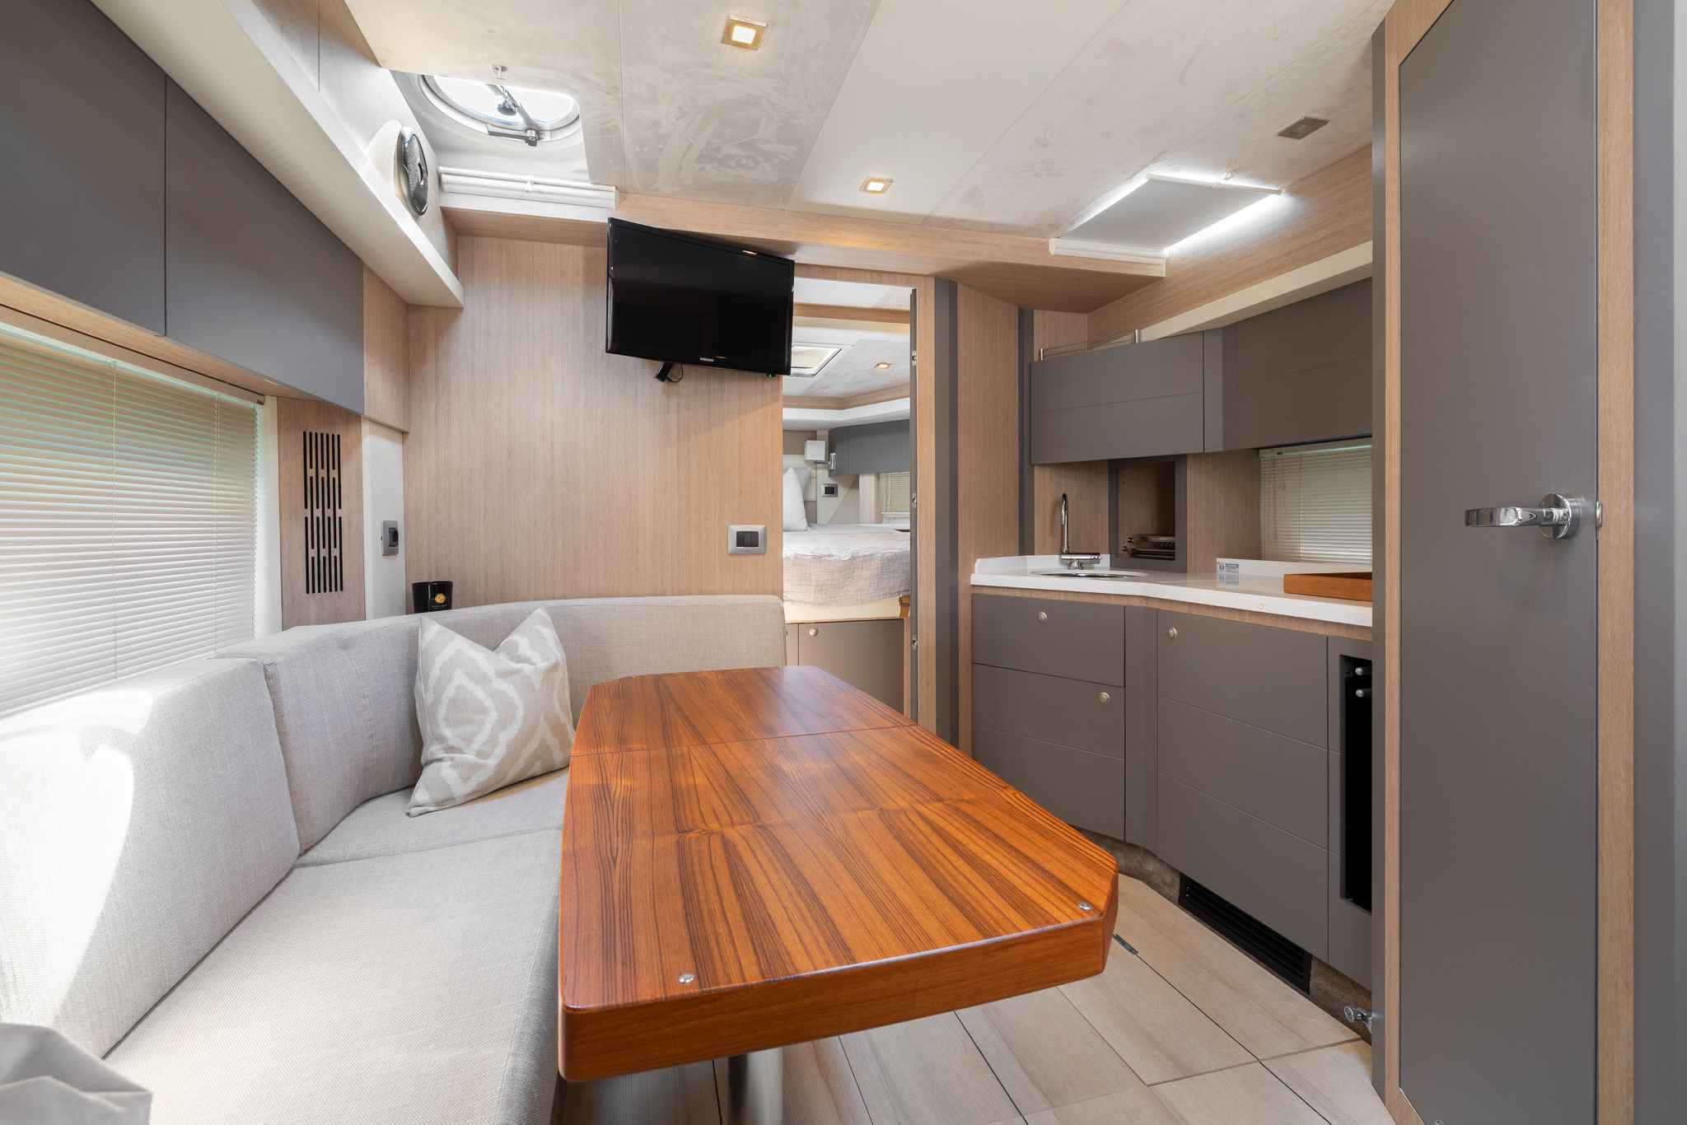
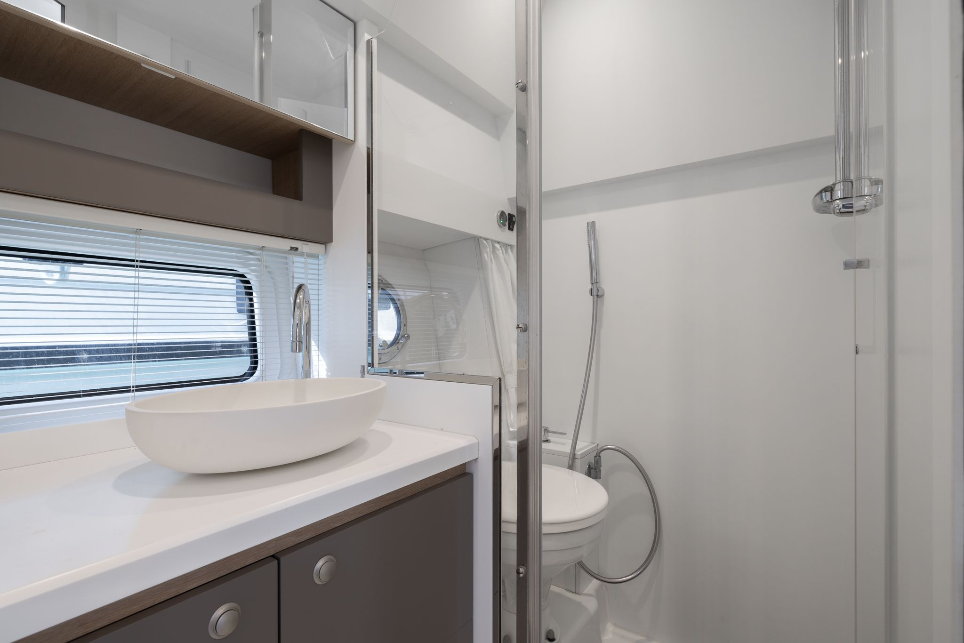
PHOTO GALLERY

Slide 5
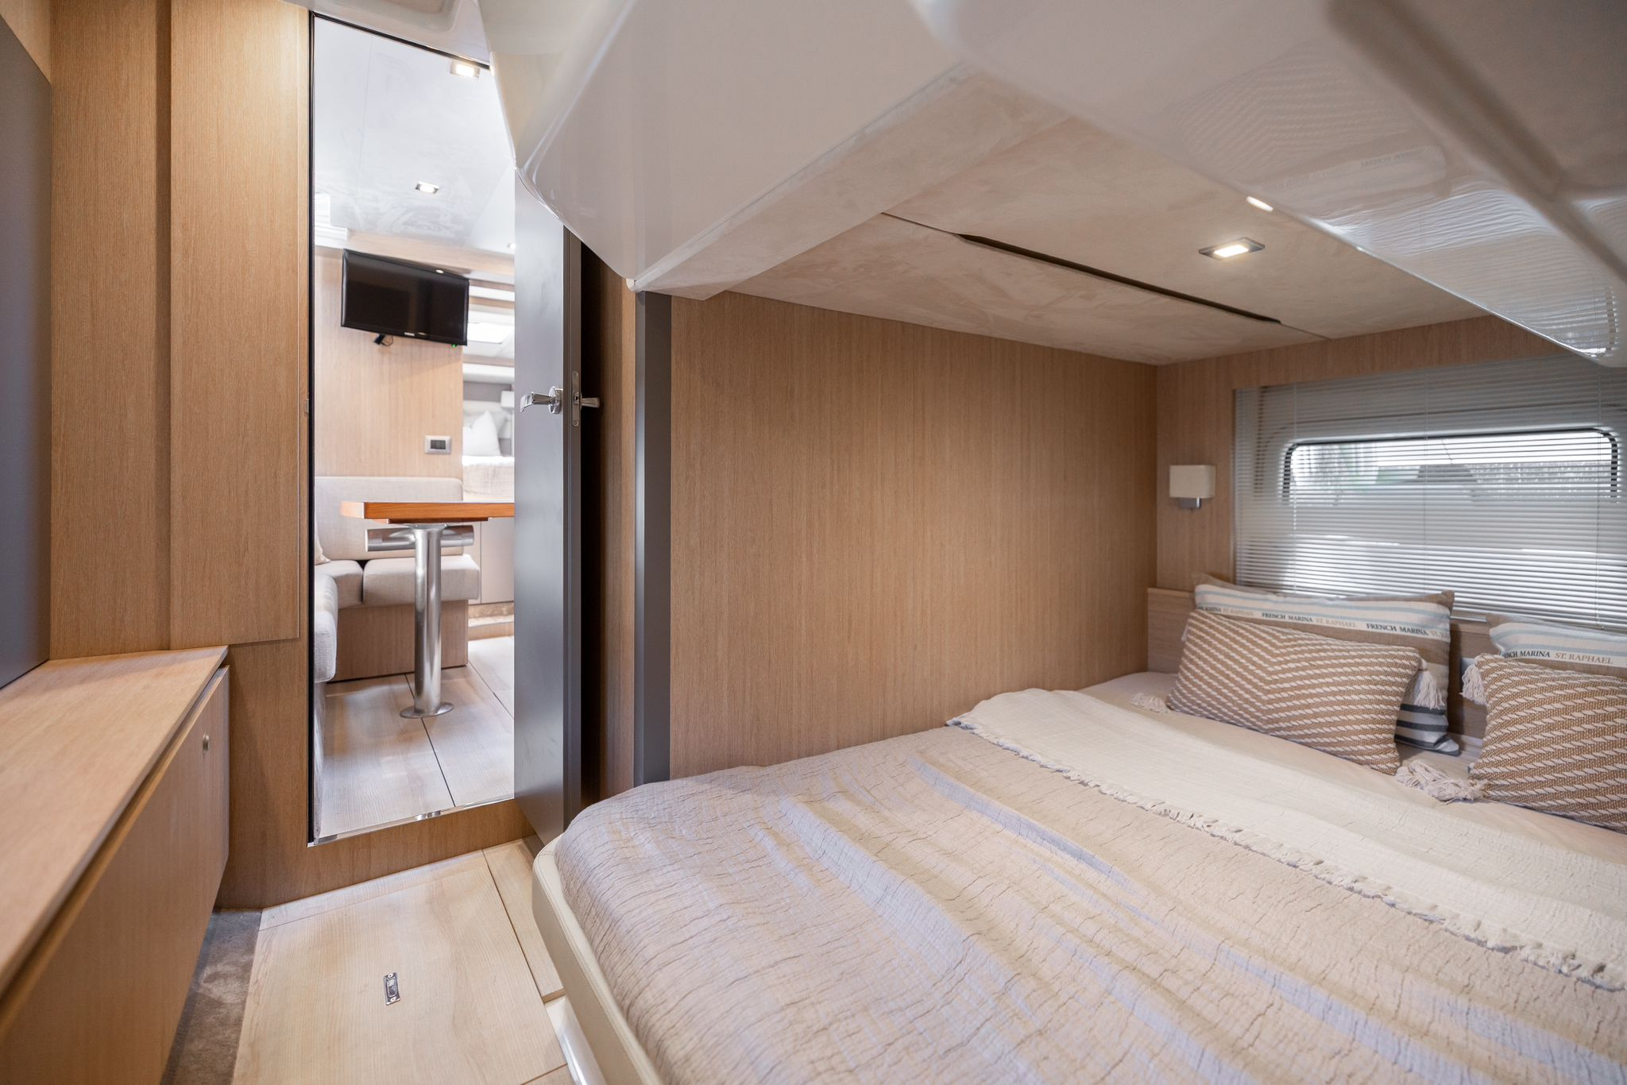
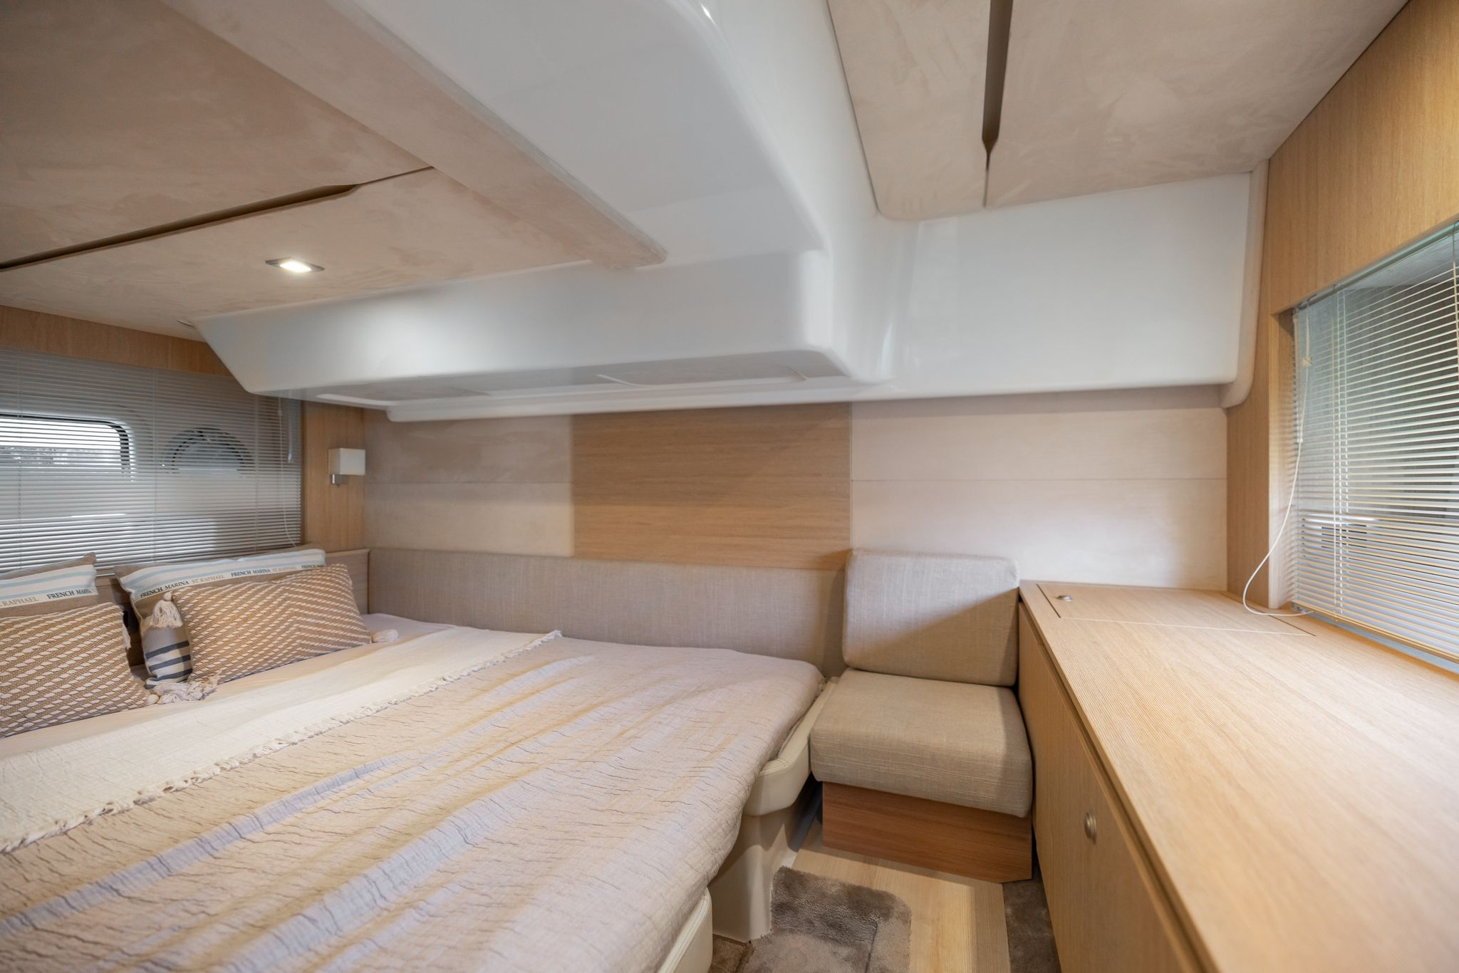
PHOTO GALLERY

Slide 6

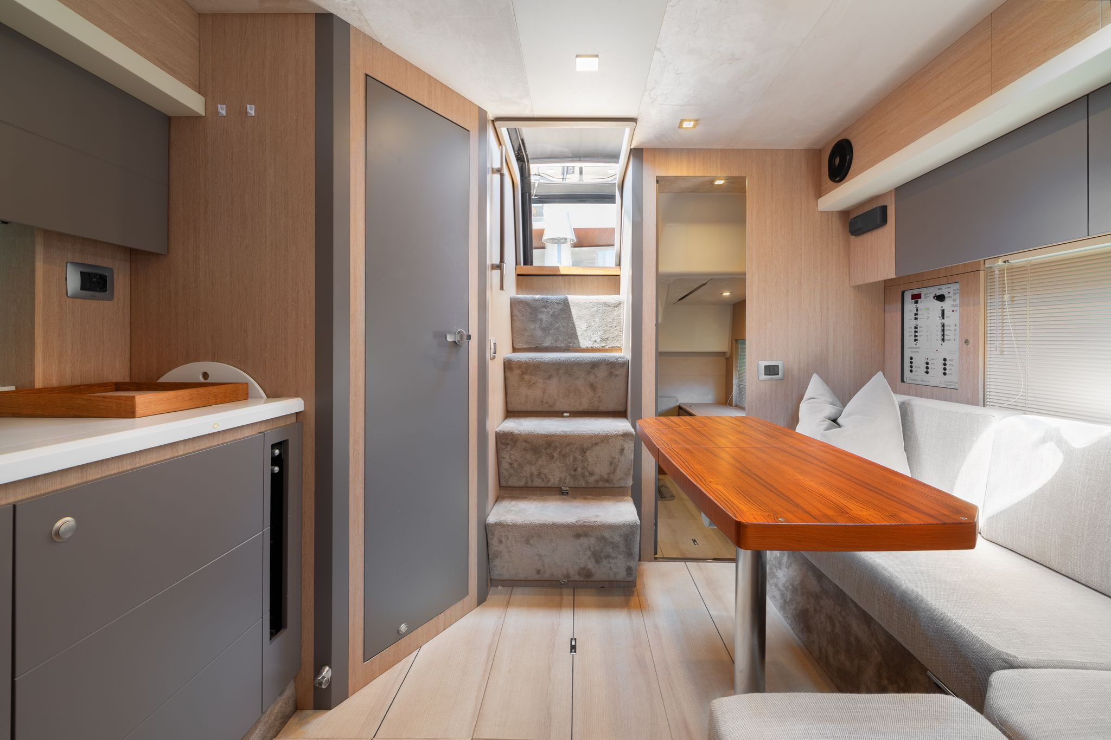
PHOTO GALLERY

Slide 7


PHOTO GALLERY

Slide 8
PHOTO GALLERY

Slide 9
PHOTO GALLERY

Slide 10
PHOTO GALLERY

Slide 11
PHOTO GALLERY

Slide 12

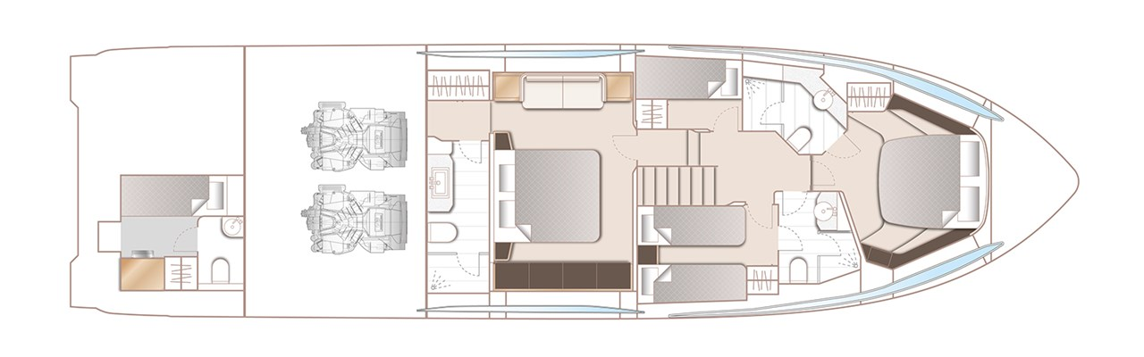
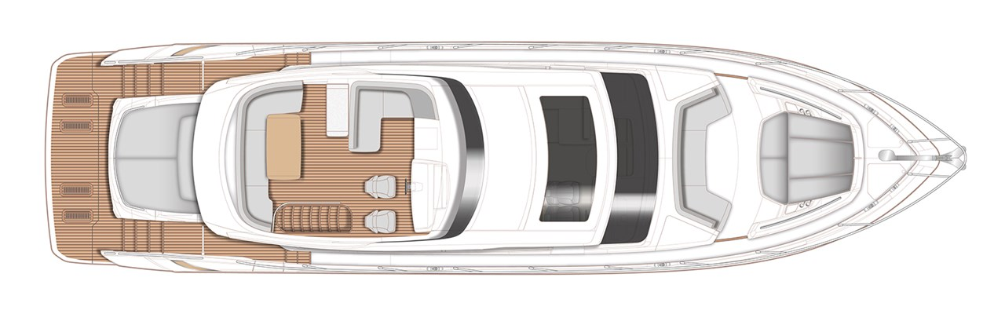
PHOTO GALLERY
see more photos on our web internautic-Yachts.com
All particulars are believed to be correct but are not guaranteed

